Slide 1


CAIRO UNIVERSITY
INSTITUTE OF STATISTICAL STUDIES
AND RESEARCHES, CAIRO UNIVERSITY
EGYPT
Using Radio Frequency Identification for Storage Optimizing based on Objects Distance
By
Ahmed Adel
Under The Supervision of
Dr. Mervat Gheith
Computer Science Department
Institute of Statistical Studies and Researches
Cairo University
Dr. Mostafa Ezzat
Computer Science Department
Institute of Statistical Studies and Researches
Cairo University
A Thesis
Submitted in Partial Fulfillment of the Requirements for the Degree of
Master in Software Engineering

Slide 2
Agenda
Abstract
introduction
Problem definition
Objectives
Previous Work
Proposed system
Conclusion
Future Work

Slide 3
Abstract
Controllership Department of ASEC El-Minya Cement Company needs to locate the spare parts in the warehouse right on time to manage many operations, such as physical inventory, handling and monitoring from the real world to save time, cost and effort. In addition, prevent fake stocking process to improve general logistics.
We have designed a proposed solution :
able to detect/scanner the locations of tagged spare parts to read its info by using fixed antennas connect with the reader by using radio waves.
and then connects with the warehouse inventory software system.
This would have many benefits in terms of tracking and identify a spare parts.

Slide 4
introduction
Why RFID???
Barcodes have been the primary means of identifying items for a long time. Customary bar-coding technology has an essential limitation:
each barcoded item must be scanned one by one, thus restricting the checking speed.
Additional when the scanning is manually executed, there is the added probability of human errors.
GPS good strategy for outside place systems – performance is not accurate to find spare parts within indoor environments – higher cost because the system connecting a GPS receiver with a radio transmitter that can be captured by satellite (which costs approximately$4,000 per tag).

Slide 5
RFID offers many advantages over barcodes and GPS, including non-line-of-sight operation - minimizing human interference - faster identification - sense spare parts and collect its info - track spare parts – suitable for indoor location system – lower cost.
Thus the companies will be able to know exactly where every item in the warehouse is at any moment of time and hence its quantity.
UHF passive RFID solution that suitable for ASEC El-Minya Cement Company by design RFID system according to the physical specification of the spare parts and company needs.
We have divided the warehouse into some sub-areas; design appropriate graphic that make the antennas easier to scanner the tags. Then, employing the (Ultra High Frequency) UHF technique between each transmitter and receiver in each sub-area.

Slide 6
Problem definition
There are many spare parts in the warehouse that vary in value, size, and shape and differ in their physical components.
For example, spare parts of coal mill , a preheater, a raw mill, and a kiln, which of course are very expensive.
The warehouse may contain costly spare parts estimated millions of pounds, hence the idea of preserving it.
on the other hand, there are several problems occur during the annual inventory, for example, many spare parts are not in their right places and its actual physical quantities is not matched with the current real stock.
That definitely affect the many departments such as supply chain department, financial department and procurement management.

Slide 7
So our main goal is to solve the problems of location detection and real stock capturing of the spare parts, and hence cost and time control.
So we propose a UHF passive RFID solution that can catch “live stock” info, trace spare parts inside the warehouse to provide the visibility and transparency for stock-taking staff.

Slide 8
Objectives
The main objective of stock-tacking processes to have the inventory spare parts at the right time, at the right quantity, and at the right place.
Can identify and manage the flow of spare parts information without human intervention in order to avoid human error.
The Information can be stored and retrieved at any time, giving better visibility for decision making.
Lower effort, since we do not need to track or locate spare parts manually.
Track and find a selected spare part that can lead to more effective utilization of item (Emergency Situations).
The growth of the company is mainly related to the tracking of spare parts: Reduce thefts - Preserving Company Resources - Buying Less Spare Parts
Immediately know where our spare parts have been allocated.

Slide 9
Previous Work
RFID Technology in Libraries
The idea of RFID can be used to identify, trace, arrange or detect library stocks everyday.
This framework, smart RFID labels, hardware, and software, provides libraries with an extra powerful manner of managing their collections with greater customer service.
The technology works thru clever labels, around 2x2 in size, which permits it to be placed inner each book in a library’s collection. The tag includes an antenna and a tiny chip which the data is stored.

Slide 10
In-library case HF band is used with 13.56 MHz, any tagged book within the range of the reader will discover the signal. Once the tag has empowered, it replies to the reader and indicates its location.
therefore, the books require much less human managing.

Slide 11
Proposed system
Overview of RFID passive - UHF system
Software Application
LLRP protocol or Multiplexer
WLAN or Cable
Active Reader
Antenna 1
Antenna 2
Antenna 3
Backscattering Electromagnetic wave
Backscattering Electromagnetic wave
Passive Tags

Slide 12
UHF - RFID system : 860-950 MHz
Hz = wave/second
The reading scope of passive UHF systems can be the length of 30m.
UHF RFID has a faster information transfer rate than LF or HF.
UHF radio waves can recognize a bigger number of tags in the area at a given time.
Microwave are used as a part of active RFID frameworks – active tag -higher cost per tag.
UHF frequencies RFID system uses communication technology called Backscattering. it's the operation of accumulating an RF signal, processing the signal and reflecting it again to wherein it originated from.
it works like a (Active)reader sends the electromagnetic wave to a (Passive)tag, the tag receives the wave, encodes the records into the wave, and scatters it again to the reader.

Slide 13
Passive - RFID system:
In passive RFID systems the Active reader antenna sends a radio signal to the Passive tag. The RFID tag then uses the transmitted signal to power on, and reflect energy back to the reader.
Passive RFID systems can work in the low, high or ultra-high frequency radio bands. As passive system ranges are restricted by the radio signal reflected from the Passive tag back to the reader.

Slide 14

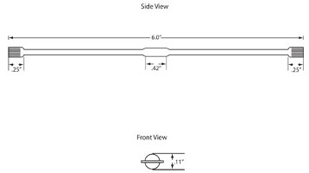
Passive UHF EPC Tag:
Small tag antenna…shorter read range, larger tag antenna….longer read range.
IN02 Embeddable RFID Wire Tag, 360-degree read profile to reduce the worry of reading angle - Harsh environment RFID tags - Embeddable into plastics, pallets, concrete, rubber, etc.
Choose the suitable tag for the item according to its material.
the reflection of RF energy and absorption of RF energy.

Slide 15
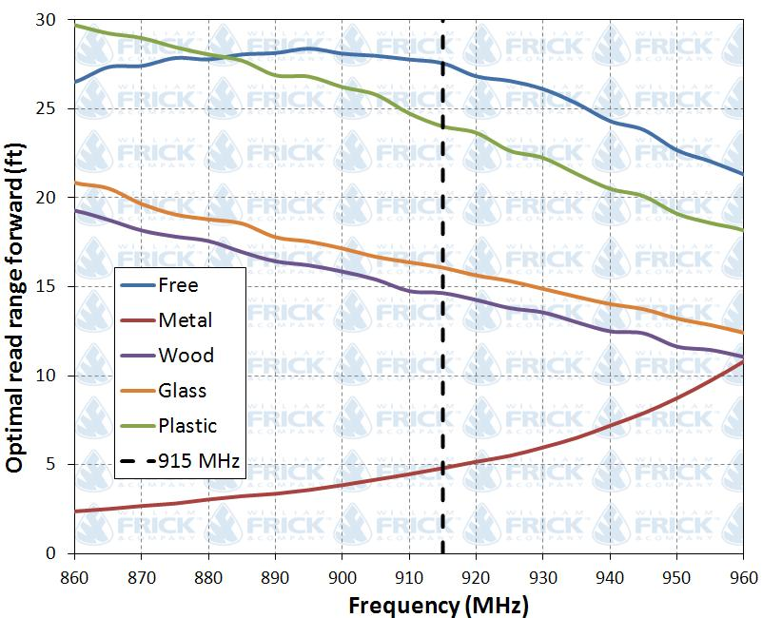

Slide 16
EPC(Electronic Item Code):
- The electronic item code number can be utilized as a key into a database to recognize a specific item.
- Can contain spare part info , expiration, warranty and storage instructions, and service history.
- Written into a tag by an RFID printer.
- Includes a 96-bit string of information:
The initial eight bits are a header which distinguishes the version of the protocol (UHF EPC Class 1 Generation 2).
The following twenty-eight bits recognize the company that controls with the information for this tag(Asec).
The following 24 bits are an object class, distinguishing the sort of spare parts – its Area.
the last 36 bits are an interesting serial number(unique identity info) for a specific tag descriptions.
- The last two fields are set by the association that issued the tag.

Slide 17
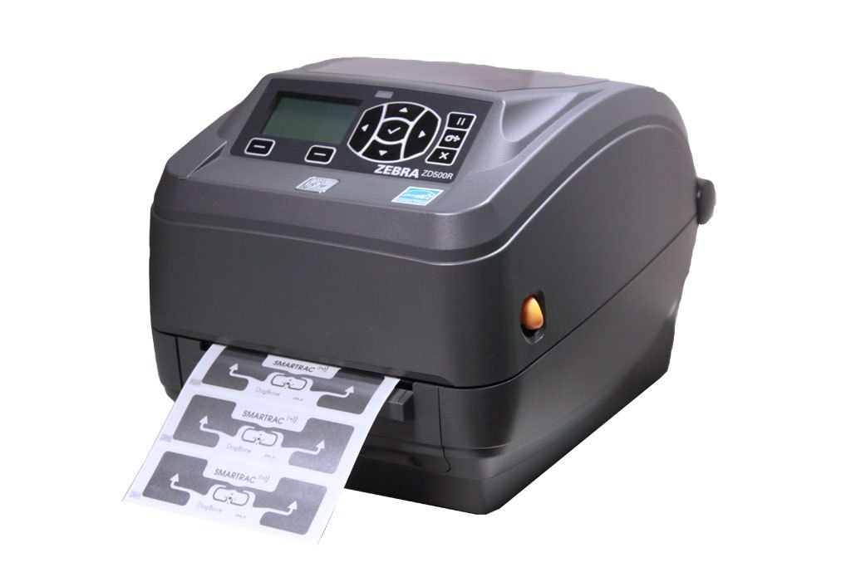
RFID printer

Slide 18
Active UHF Reader:
Readers are set up to make a particular inquiry zone which can be firmly controlled. This permits an exceedingly determined reading zone for when tags go all through the inquiry zone.
it comprises a read or read/write unit and a connected to (internal or external)antenna.
Empower tags – send Signals – listen and pick up the Tags(read- receive info) – process info –store info – checks the quality of the data transmission.
Higher power settings will bring a greater read range, while bring down power settings will bring reduced read range.

Slide 19
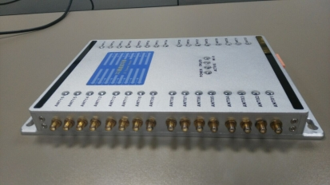
- Could connect 32 external antenna.
- Multiple tags reading ability.
UHF RFID Reader 32 Ports Channel Reader

Slide 20
Antenna:
Several antennae can be mounted away from a reader unit and positioned strategically to enhance the quality and range of the radio signals.
UHF reader antennas can be categorized around a:
- circular-polarized antenna: split the power from the Antenna across two axes to cover as many places as possible - get radio waves from all directions - smaller gain(short range).
- linear-polarized antenna: work best in one specific direction - narrower area- - higher gain(long range) - tag orientation very more significant with linear antennas.
Polarization refers to a type of electromagnetic field the antenna is generating. The choice between circular polarization antennas and linear polarization antennas can make a significant difference in an RFID system.

Slide 21
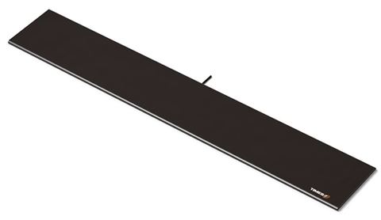
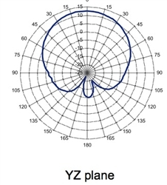
linear-polarized antenna -Times-7 A5531 Indoor Antenna
linear-polarized

Slide 22
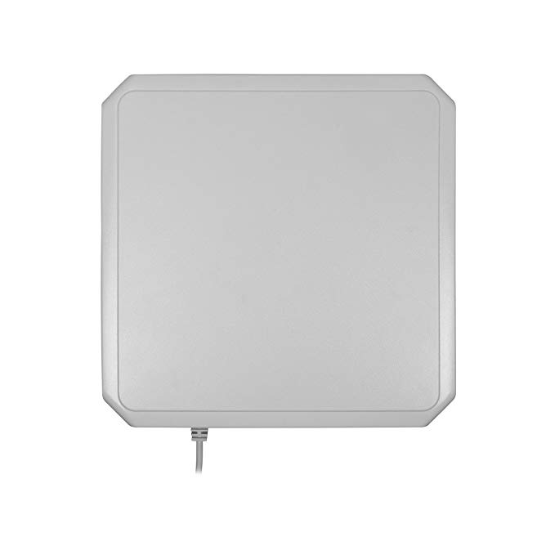
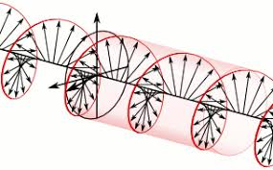
Circularly polarized antennas, such as the Laird S9028PCR Indoor RFID Antenna and the MTI MT-242043 Outdoor RFID Antenna, emit electromagnetic fields.
linear polarized antennas , such as the MTI MT-263003 Outdoor Antenna, and the Times-7 A5531 Indoor Antenna.
Circularly polarized antennas -Laird S9028PCR Indoor RFID Antenna

Slide 23
Solution Implementation:
The company needs to implement a system to locate their expensive spare parts. They hope to have an inventory system to produce active protection, which means every item enables to be identified, tracked and monitored.
1- Tags attached to each item. We will use in our system UH113-MZ3 passive tag. These tags decrease the problems UHF RFID faces around metal. Every object can be identified by an electronic product code in an automatic manner.
2- R2000 Long Range TCP/IP Reader 30M, which achieve high-speed processing operations, the stable reading distance could reach 30M, multiple tags reading ability and High sensitivity to tag. And the most important characteristic of its performance that high scanning speed of RFID reader up to 300 tags/sec.
RFID readers use a standardized language called Low-Level Reader Protocol or LLRP. LLRP is a standardized protocol that any application can use to support RFID readers.

Slide 24
3- UHF RFID reader antenna A100 is designed by Scirocco Company.
The antennas are mounted far from the reader unit and situated strategically to upgrade and enhance the quality and scope of the radio signals. All tagged spare parts can be automatically monitored and locate its location.
4- The software system is used to manage, trace, locate and manipulate the data transmitted between the tag and the reader.

Slide 25
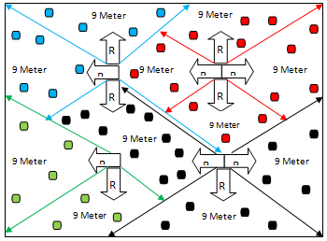
Distribute RF readers inside the warehouse

Slide 26
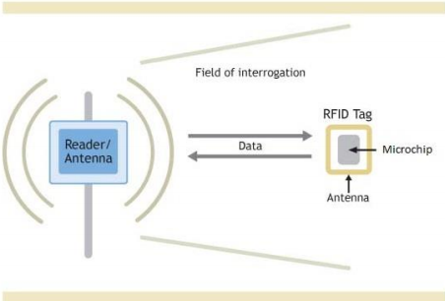
Communication between RFID passive and active Reader within UHF system

Slide 27
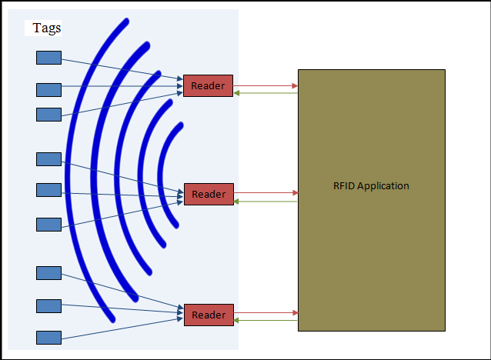
Communication between RFID system components

Slide 28
Software:
the major functions of system software are the ability of data collecting, information management, monitoring and tracking warehouse spare parts, identify its locations accurately and integration with all hardware parts of the system.
It can be summarized in the following:
1- Efficient spare parts tracking: the system tracks the spare parts without traditional stocktaking and inquiries a selected item and immediately getting spare part locations info and its quantities.
2- Easier item location: the company no longer need as much staff to actively manage the stocktaking .

Slide 29
Software:
- After distributing the antennas to cover all areas inside the warehouse, many places are located in a share range (more than one reader).
Duplication quantity of the selected spare part
product location is reached by two antennas.
We have suggested a solve by naming the readers with alphabetic characters and using the character sequence to determine the location of the inquired spare part and calculate its quantity.

Slide 30
B
A
intersection area between two antennas

Slide 31
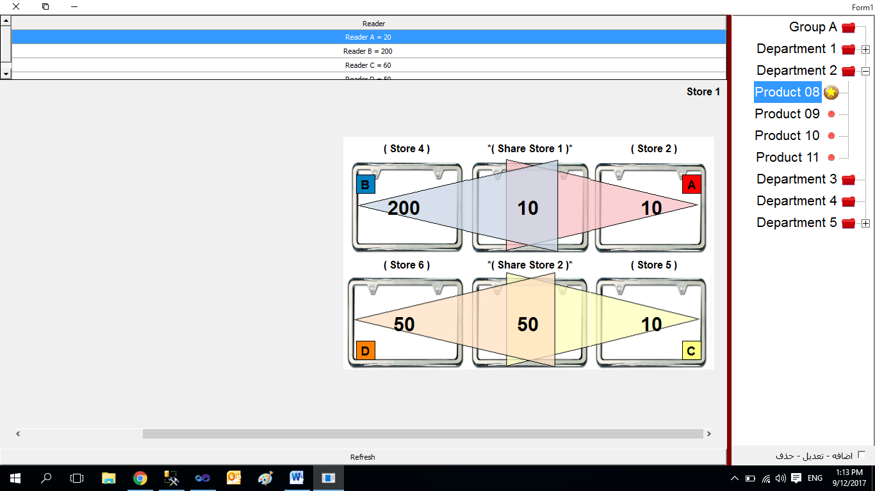
Showing the Places of the selected product in the warehouse

Slide 32
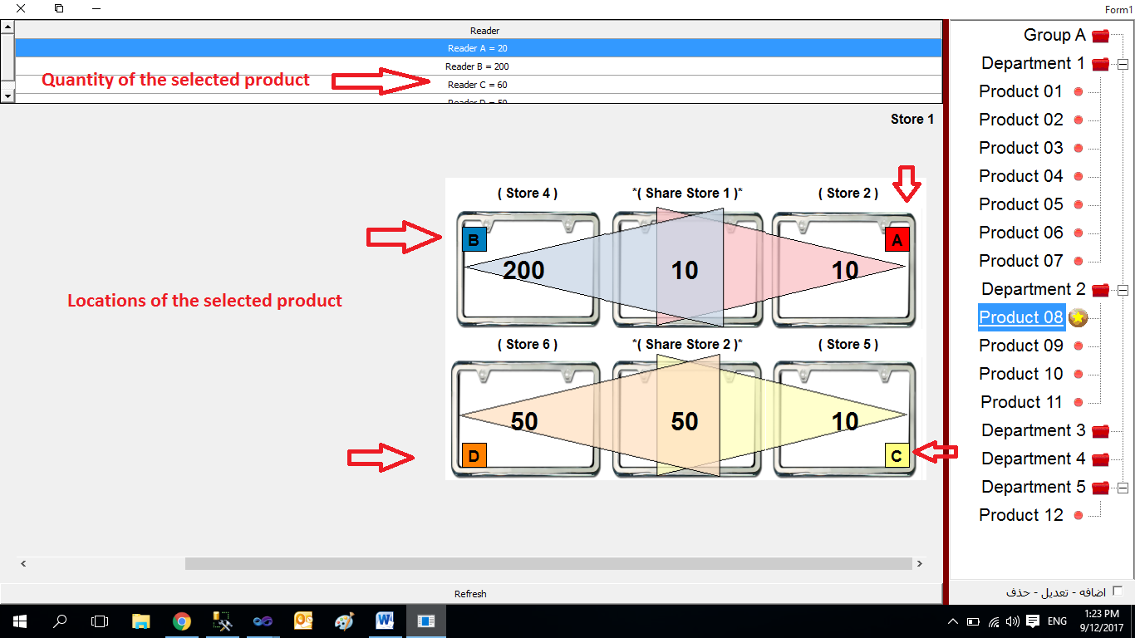
Showing the quantity based on each location

Slide 33
Since we cannot do an actual experiment with the high cost for us, we recommend that the experiments will be carried out by at least two kinds of readers.
The aim of the solution is to test the performance characteristics of different Passive UHF RFID tags when attached to different spare parts. There are 2 different tags on which the tests will be performed, with different kinds of items.
Both the Backscatter analysis and Electromagnetic field threshold will be carried out on the tags with and without the items.
All the tests will be carried out for two different environmental conditions. All the tests will be carried on all the items in the same setup and at the same time.

Slide 34
Conclusion
- We have developed an RFID tracking system for improving the inventory process in the warehouse through developed a method to locate products.
- The system requires simple tools like: an RFID reader, group of antennas, groups of a tag and software.
- Briefly, we can mention the system tasks:
Determine the current position info of the selected item in the presence of thousands of items in a warehouse in the a shortest possible time. – easily stocktaking.
Automatic update of currently item quantity (sensing of live-stock status).

Slide 35
Prevent spar part shortages and allowed to keep just enough stock.
More organized warehouse.
Save time, cost, and effort.
Increases efficiency and productivity.
Reduce the chance of misplacement, and also can help the users to find the missed items.

Slide 36
Future Work
The idea will be presented to the chairman of the board of directors for its implementation in the next year. This is done before making the general budget of the company. This can be achieved after presenting and agreeing on it through the warehouse manager and general manager of the factory.
The idea has already been presented to the warehouse manager and warehouse supervisor during the past few days. They found it is productive and can solve problems of warehouse from which we suffer few years ago. The idea was also presented to inventory team of financial department. they found that the idea is valuable and they are the first beneficiaries after implementing the idea of remotely inventory especially after their suffering that they found in each stocktaking.

Slide 37
Thank you for your attention

